Slide 1
W06D3
Optimization
Instructor: Jeremy Eng
Slides: Eric Elmoznino
Notes:
This lecture provides you with the details on how a lot of the ML algorithms work.
They usually want to optimize something: Minimize loss

Slide 2
Outline for today
Issues and challenges in ML
Optimization
Gradient descent
Stochastic (and mini-batch) gradient descent
Regularization
L1 (Lasso) regularization
L2 (Ridge) regularization
Elastic Net regularization

Slide 3
Issues and challenges in ML

Slide 4
Machine learning at its worst
Machine learning models fit the data we give them
If the data is sexist, the model will be too. If the data is racist, the model will be too. Any bias in the model is a pattern that the model will learn
Amazon trained a recruiting model that exhibited gender bias
COMPAS predicted risk of repeating a crime and exhibited racial bias
We want models to be fair and objective, so this is a big issue
The bias is not in the model; it is in the data. Models learn correlations
Be wary of thinking of these models as “artificial intelligence”. They don’t think, they find patterns in data
Notes:
Amazon model looked at resumes to make hiring decisions.
Classification task: Hire or not hire
Data was sexist: for candidates with similar qualifications, hiring managers were more likely to hire males.
COMPAS looked at survey responses to evaluate risk of repeating a crime, and judges used it to inform sentencing decisions.
Classification task: Will or will not commit a crime.
COMPAS has been being used by judges to help them make their decisions since 2016. Algorithms can have serious consequences.
In both cases, algorithms were designed specifically not not be biased. Resumes didn’t specify gender, surveys didn’t ask about race. Other variables were correlated with these features.
In surveys, easy to see how survey questions could be correlated with race (e.g. where you grew up).
In resumes, where do you think the bias came from? Language. Men used more masculin terms such as “executed” and “captured”

Slide 5
Optimization
Notes:
Finding parameters (e.g. weights in a linear regression model) that minimize some cost function. If cost function is the mean squared error between your model’s predictions and the true values, then this is what we are trying to minimize using optimization techniques.
Will talk about one optimization technique which is the most popular and underlies how learning is done in most machine learning models: gradient descent.

Slide 6
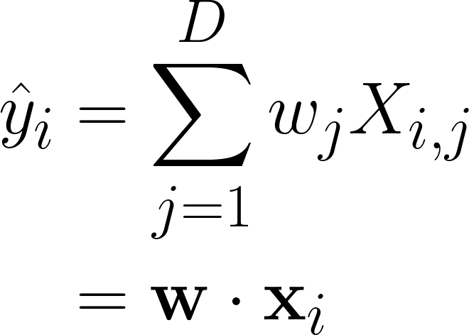
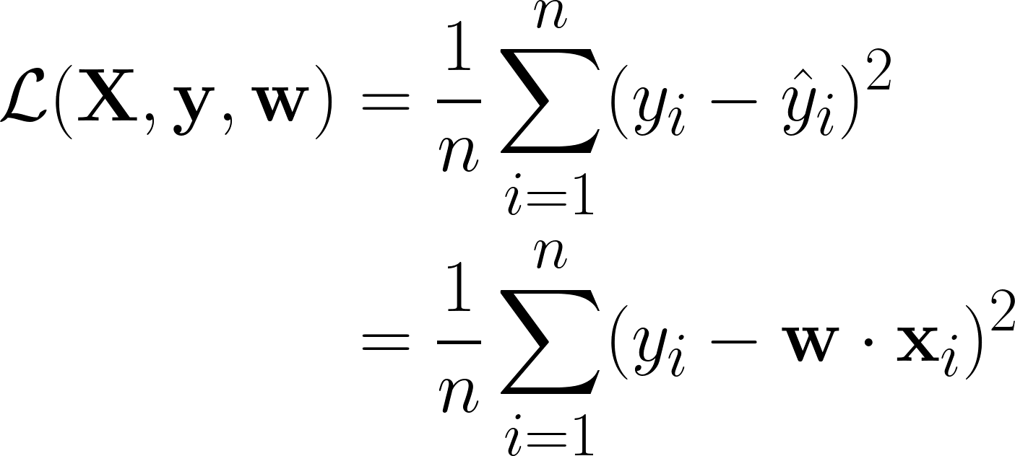
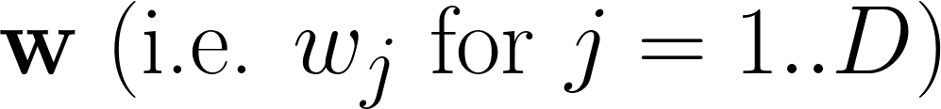
Models, parameters, and loss functions
A model: linear regression
A loss function: MSE
It’s parameters: weights

Slide 7
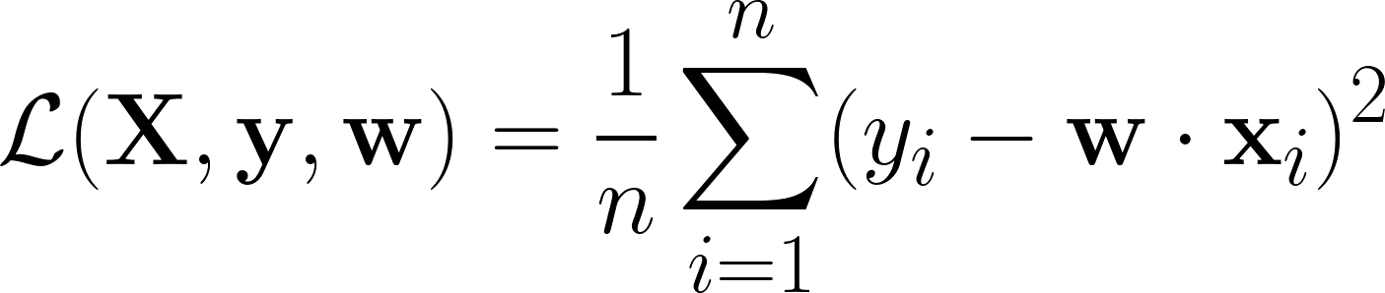
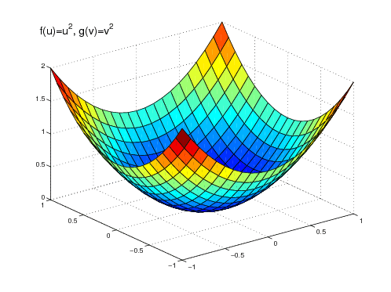
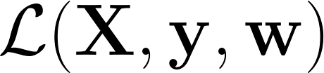
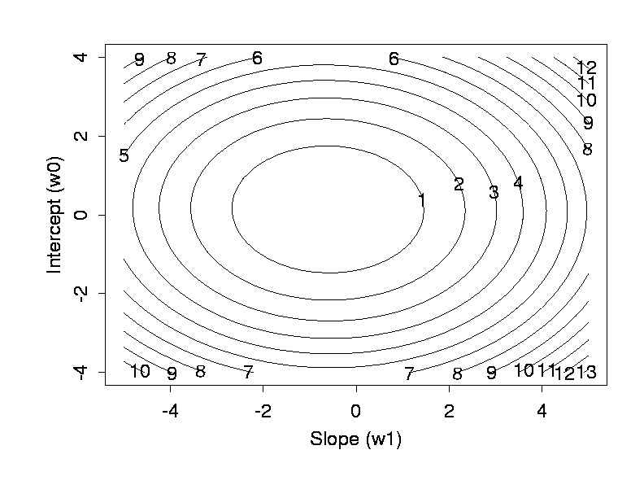
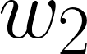
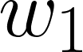
Loss landscapes

Slide 8
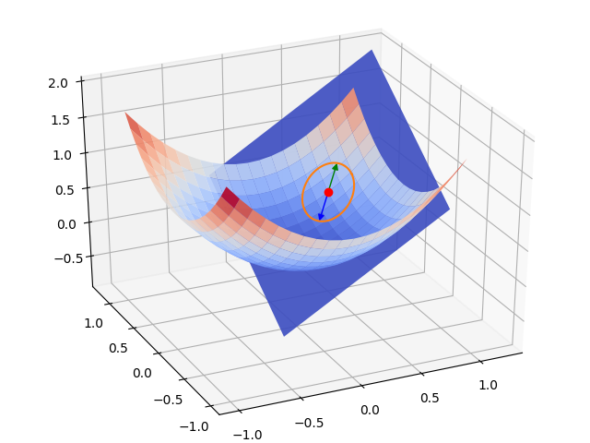
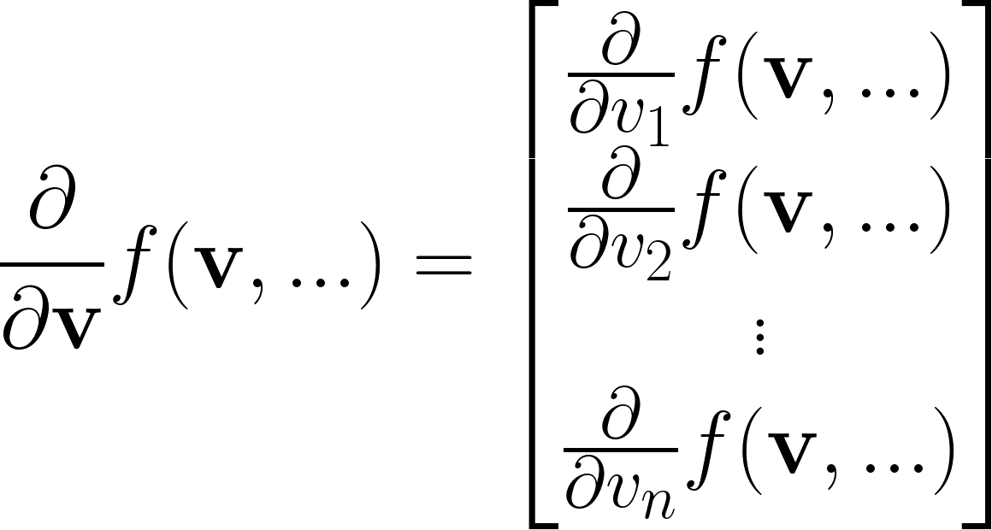
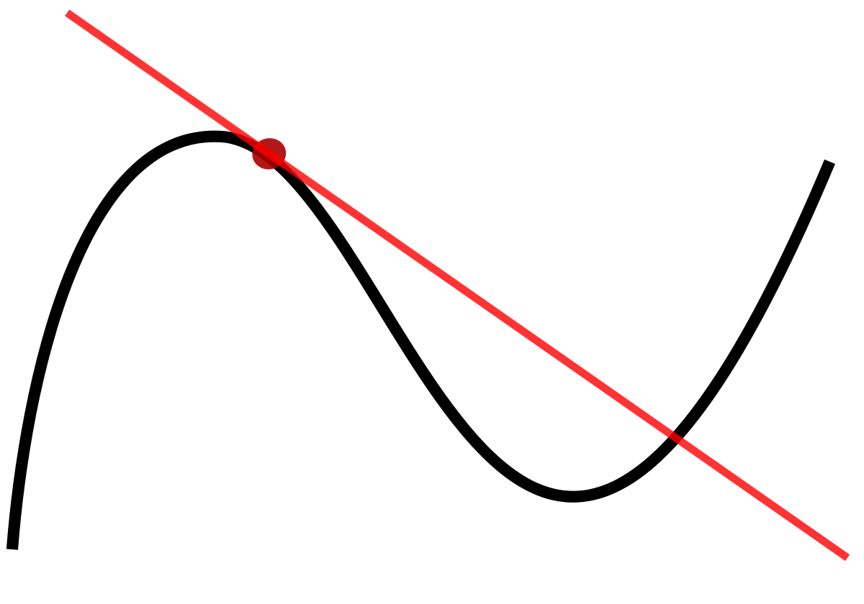
The gradient: multidimensional derivative
Derivative for 1D independent variable (slope)
Derivative (gradient) for >1D independent variable (slope + steepest direction)
Derivative of function with respect to a vector
Interpretation: f would increase most if v moved in this direction

Slide 9
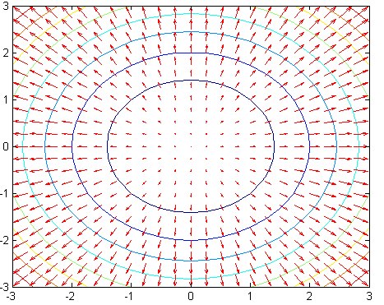
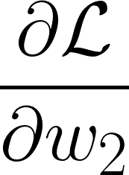
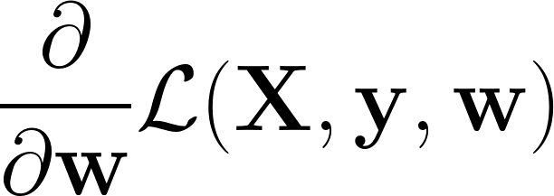
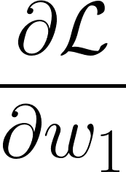
The gradient: multidimensional derivative
Direction of :
Size of :
Steepest ascent
Slope

Slide 10
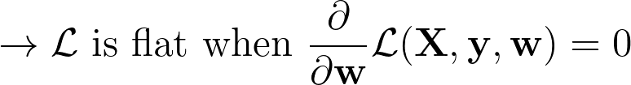

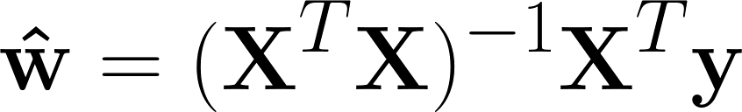
Making the gradient = 0
Lowest loss (best performance)
Just solve for , right!? For linear regression:

Slide 11
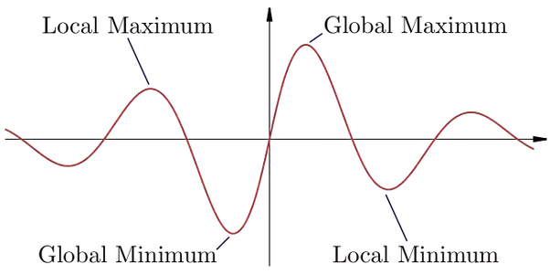
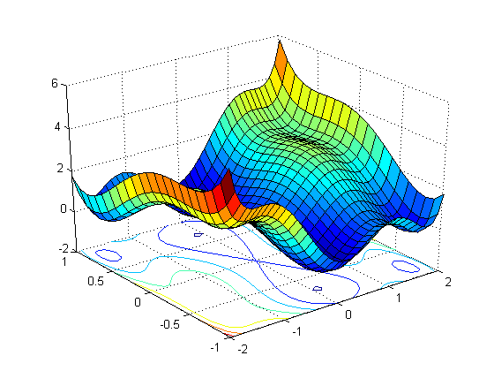
Making the gradient = 0
Sometimes, we can’t solve for the w that makes the derivative (gradient) of the loss function 0 (e.g. deep neural network)
Other times, there are multiple solutions where the gradient will be zero and the loss function is in a valley (i.e. loss function is not convex)

Slide 12
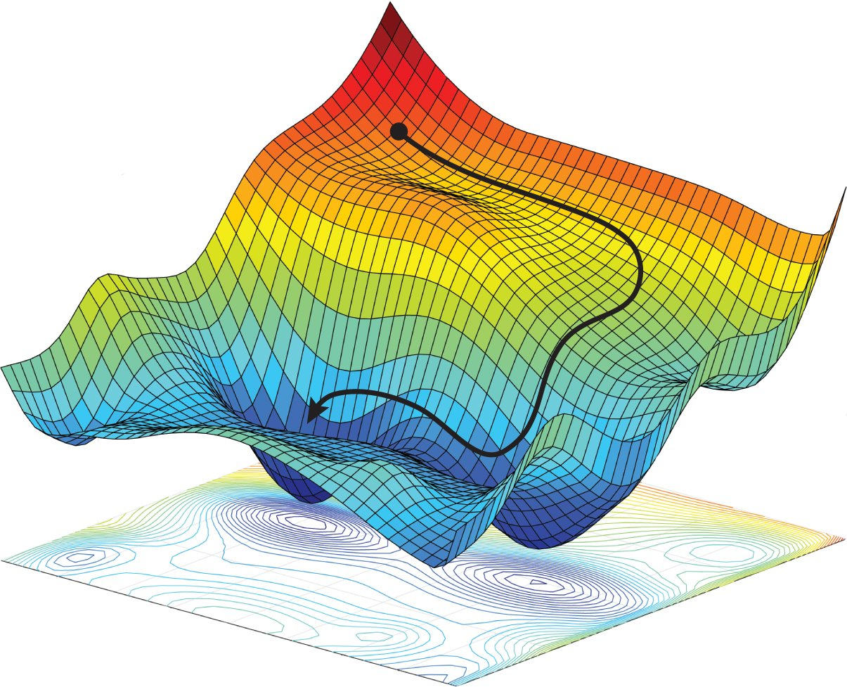


Gradient descent: going downhill

Slide 13
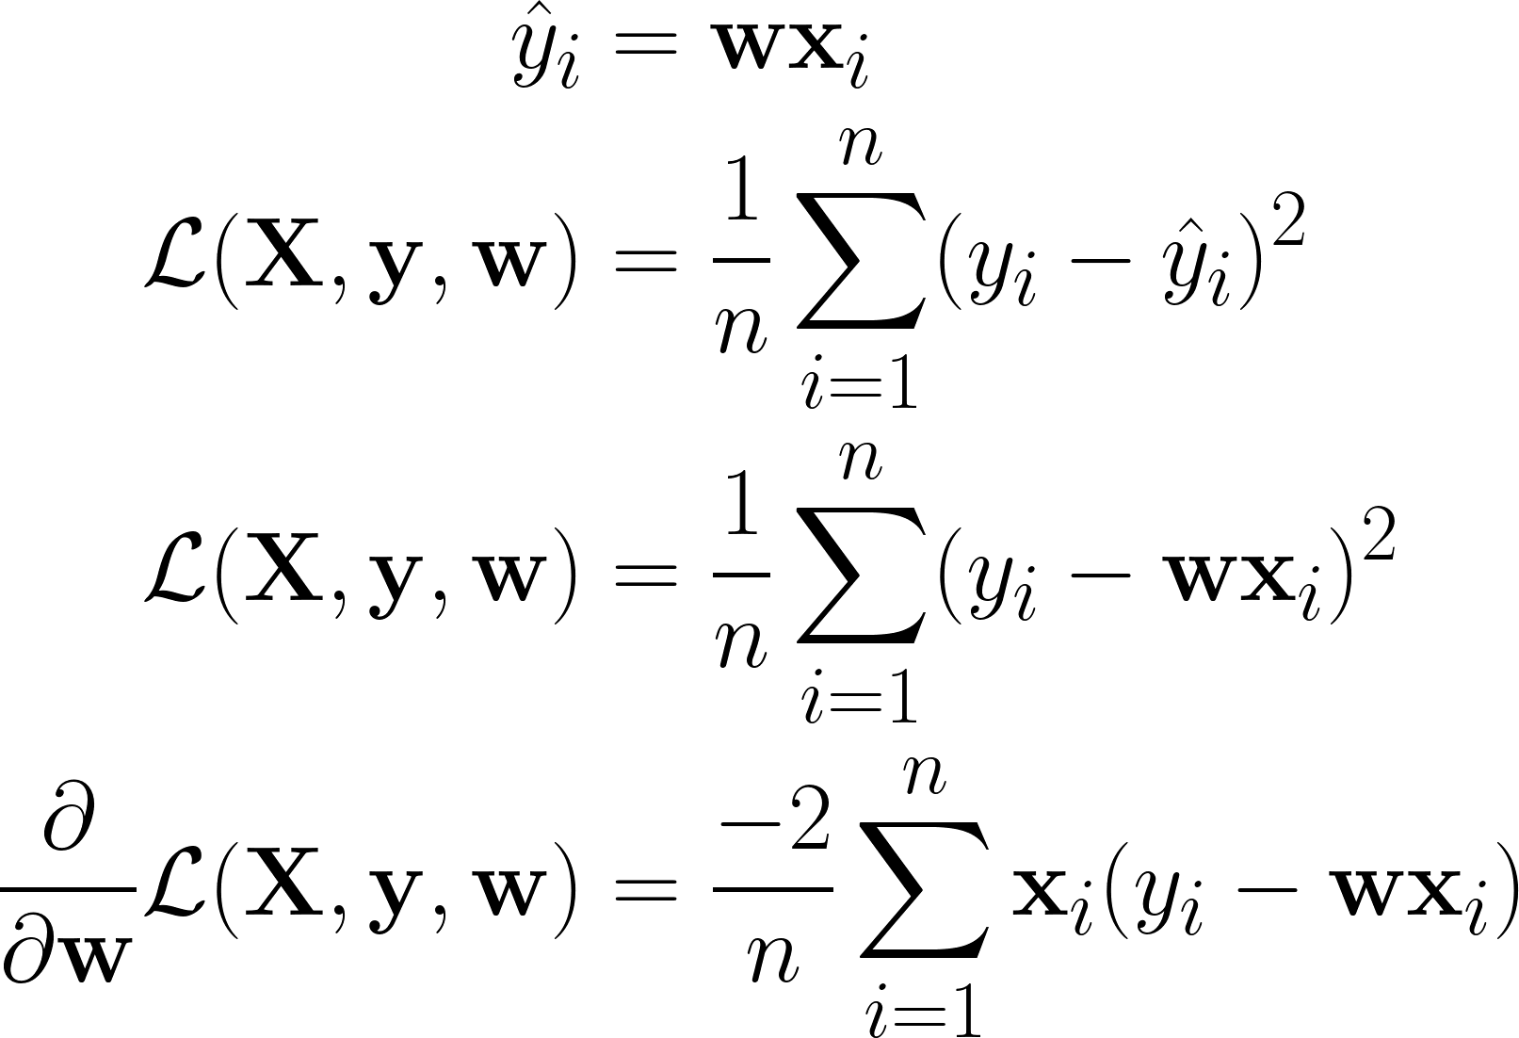
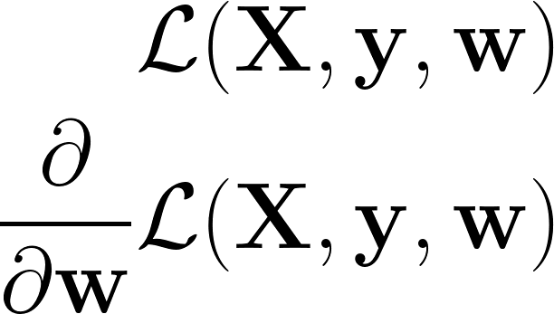
Gradient descent
Example for linear regression
Loss function with respect to data, labels, and parameters
Gradient: derivative of loss with respect to parameters

Slide 14
Gradient descent algorithm
Initialize the weights (e.g. randomly)
Compute the gradient of the loss function with respect to the weights The loss function would increase if we moved the parameters in the direction of this gradient
Adjust the weights in the opposite direction of the gradient so that the loss function would decrease The weight are now better because they result in a lower loss. This is the goal of training
Repeat (2) and (3) several times so that the loss gradually decreases
We can always use gradient descent to optimize a set of weights, so long as the loss function is differentiable with respect to those parameters

Slide 15
Gradient descent decisions
How much do we move in the opposite direction of the gradient each update iteration? This is called the learning rate
Optimal setting depends on your model and the loss function
Don’t know the optimal value beforehand. Try different values, see which is best
Doesn’t necessarily need to be a constant value (learning rate scheduling/annealing)
How many update iterations do we want to perform?
Can use a constant value. Number of times we update using the entire dataset is called the number of epochs
Can keep updating until loss stops decreasing (i.e. loss has converged)

Slide 16
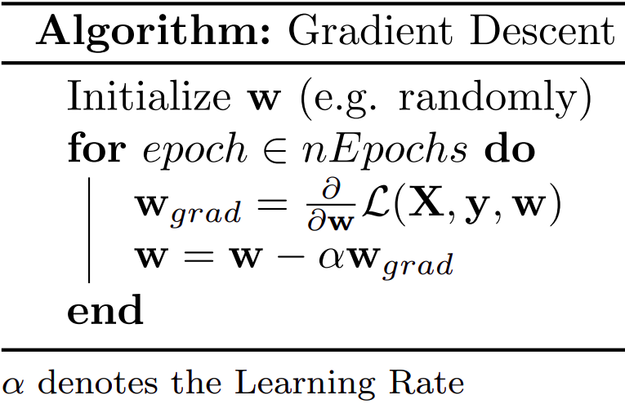
Gradient descent algorithm

Slide 17

Effect of the learning rate
Learning rate too large: end up missing the local minima (overshooting)
Learning rate too small: learning takes too long (too many iterations)

Slide 18
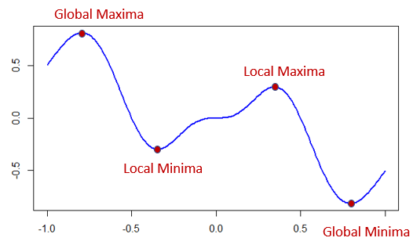
Stochastic gradient descent
Issues with gradient descent:
Computationally expensive and slow (uses the entire X dataset for each weight update)
Can get stuck in bad local minima (never goes uphill)

Slide 19
Stochastic gradient descent
Issues with gradient descent:
Computationally expensive and slow (uses the entire X dataset for each weight update)
Can get stuck in bad local minima (never goes uphill)
Solution: stochastic gradient descent
Randomly select one data point (row in X) and update using its gradient
Results in noisy approximate of the true (full dataset) gradient
In practice, using noisy updates converges to better solutions that are closer to the global minimum (can escape bad local minima)
Notes:
Stochastic means random. Stochastic gradient descent gets its name from randomly picking a data point for each update.

Slide 20
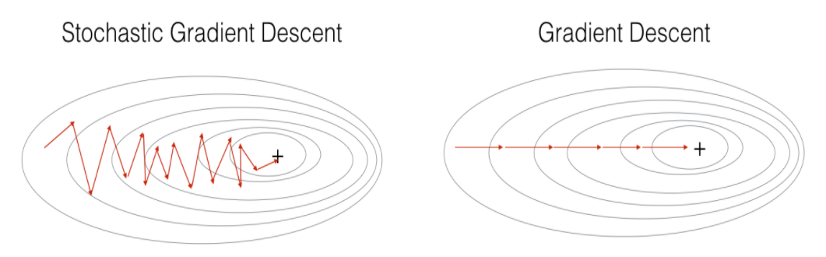
Stochastic gradient descent

Slide 21
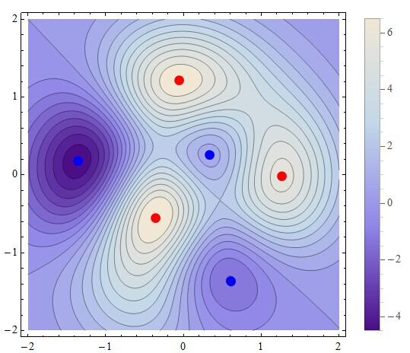
Stochastic gradient descent: escaping bad minima

Slide 22
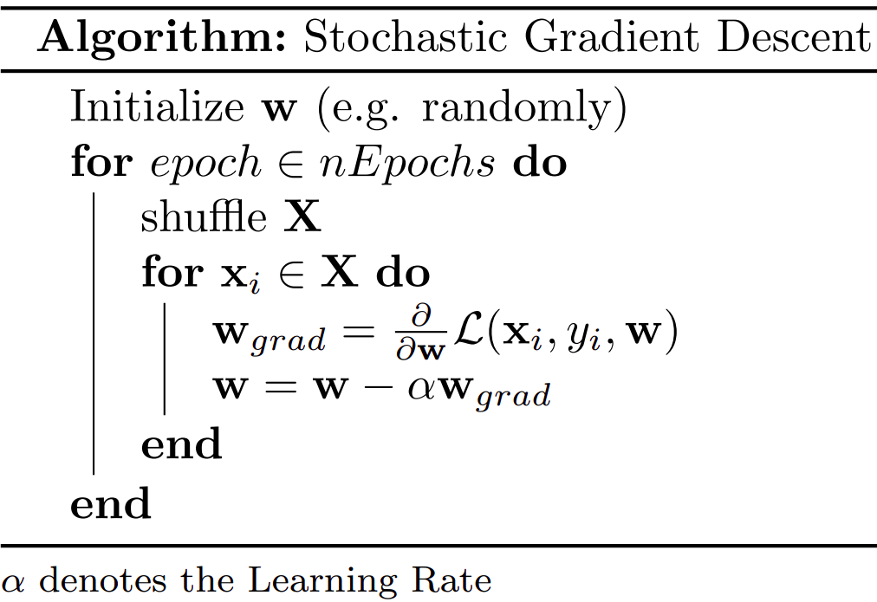
Stochastic gradient descent algorithm

Slide 23
Mini-batch gradient descent
Noise (i.e. randomness):
A bit of noise can help us find the optimal solution by escaping local minima
Too much noise can slow training due to lack of sustained downhill progress
Computational efficiency:
Big matrix multiplications may make our computers run out of memory
Small matrix multiplications may not make efficient use of parallel computing
We often want something in between: estimate the gradient each iteration using some, but not all of the data

Slide 24
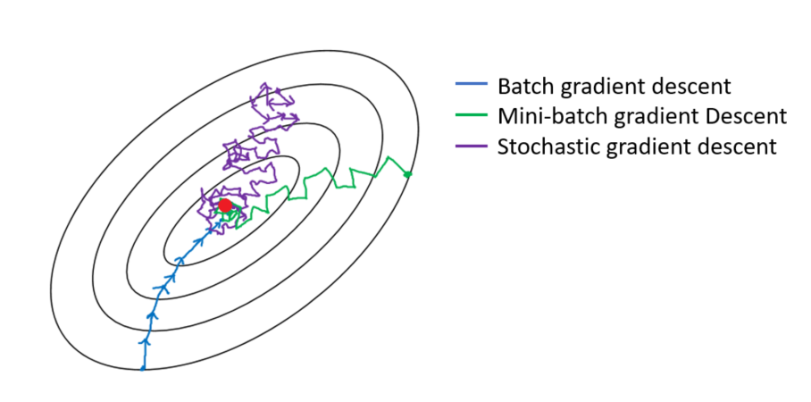
Mini-batch gradient descent

Slide 25
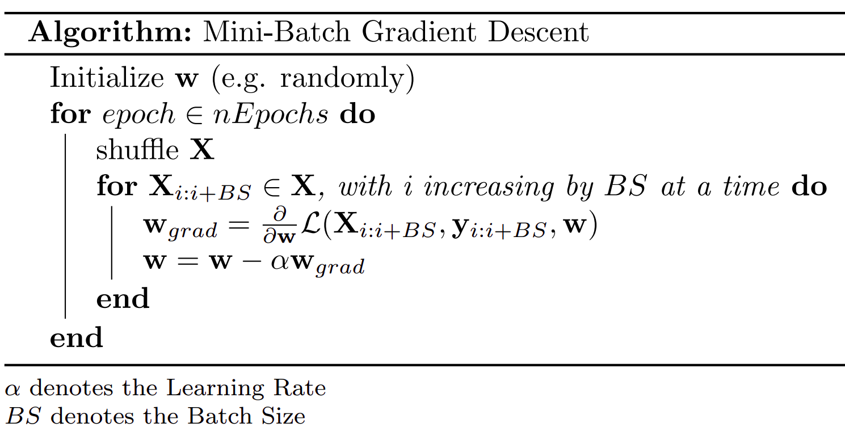
Mini-batch gradient descent algorithm

Slide 26
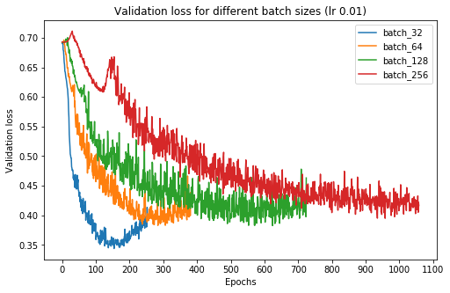
Effect of the batch size
Note: graph is for a deep neural network (many local minima, noise is more important)
Not the same as # of iterations (updates)

Slide 27
Regularization

Slide 28

Overfitting
y
y
y
x
x
x
x
Notes:
You will cover overfitting in more detail tomorrow

Slide 29
Overfitting
Data has two components components: signal (pattern) + noise
Example: predicting house prices from # of bedrooms, area, age, etc.
Signal: degree to which these features actually influence the price
Noise: spurious relationships between these features and the price in your dataset
Goal of machine learning: learn the signal, ignore the noise
When the model is learning the noise, we say that it is overfitting
Overfitting is undesirable, because the noise is spurious and therefore won’t be the same on new data seen out in the real world

Slide 30
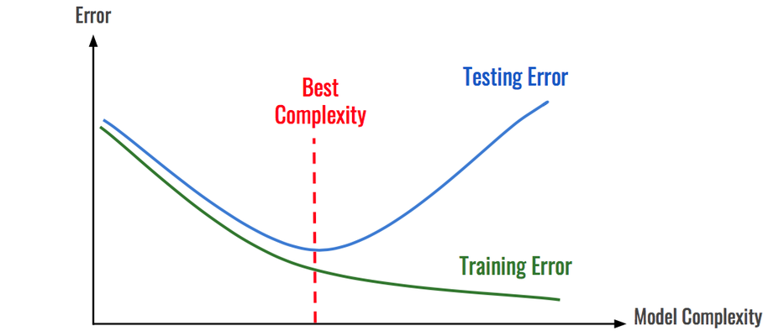
Overfitting and model complexity
(data that you evaluate your model on)
(data that you train your model with)

Slide 31
What is model complexity?
The space of functions a model can learn
Influenced by:
Model architecture (structure, type)
Model flexibility (e.g. number of parameters)
The particular solution we converge to (i.e. final parameters)
Example for linear regression architecture: parameters come from weights connecting features to dependent variable
Complexity of linear regression models increases as the number of parameters increases
The number of parameters increases with the number of features you use (dimensionality)

Slide 32
Combating overfitting
Option 1: use a less powerful model
Option 2: reduce the number of parameters
For linear regression, corresponds to reducing the number of features (dimensionality reduction or feature selection)
Option 3: limit the parameter space (effectively reducing the space of possible functions the model can learn)
A common way of doing this is to use parameter regularization

Slide 33
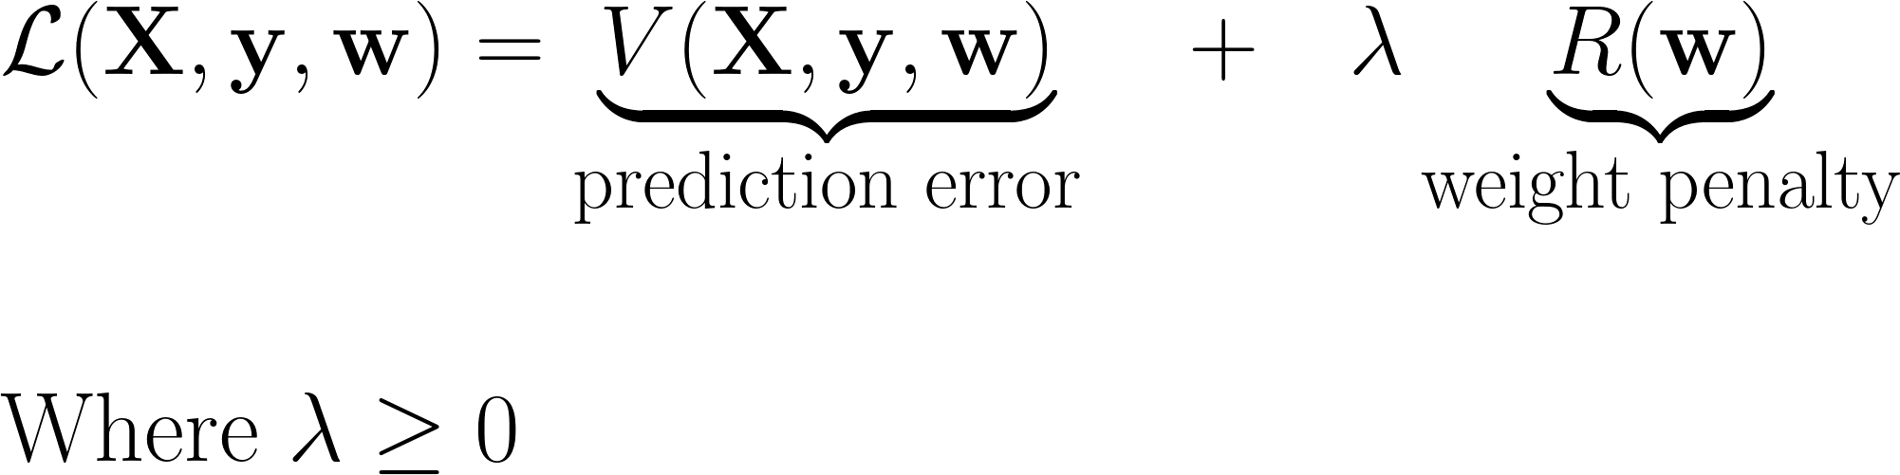
Regularization
Constrain the parameter space by adding an additional loss term on the model parameters
With this weight penalty, parameters can no longer vary freely

Slide 34
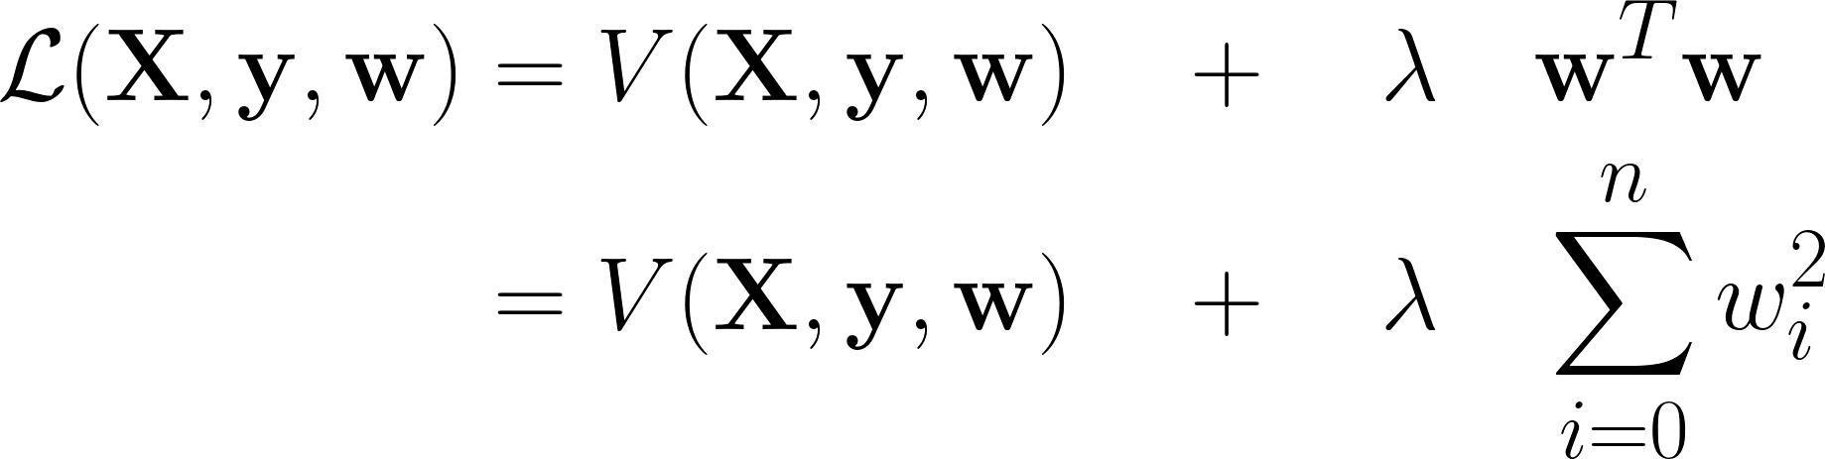
Ridge regression
Uses an L2 penalty (penalizes weights based on their squared sum)
In practice:
Prevents overfitting when there is a lot of collinearity (correlation) between the features
Model has reduced variance (more consistent model for small variations in the data)
Irrelevant features get small weights, instead of being used by the model to fit noise

Slide 35
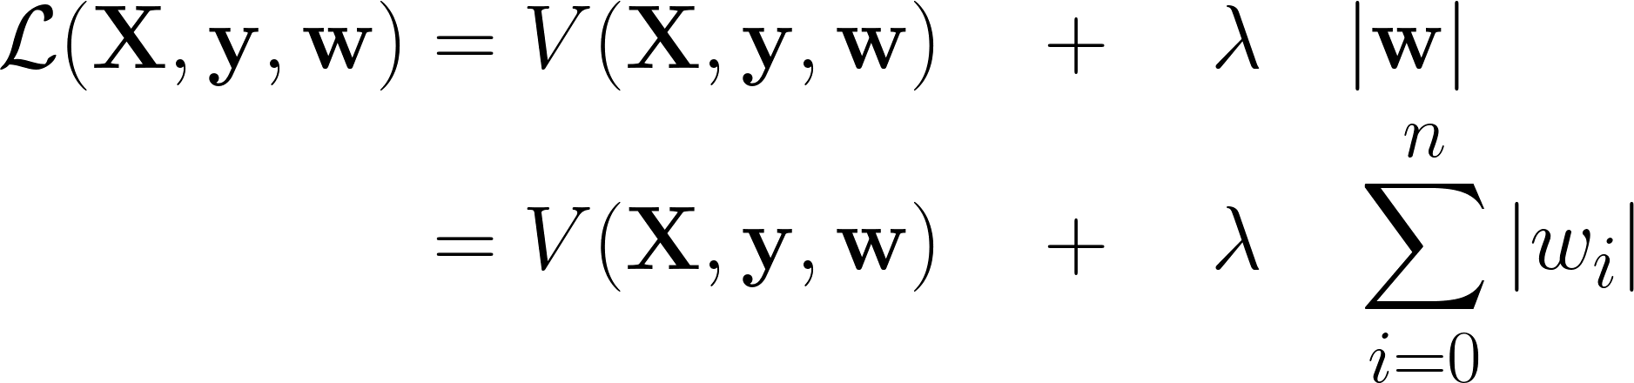
Lasso regression
Uses an L1 penalty (penalizes weights based on their absolute value sum)
In practice:
Prevents overfitting when there is a lot of collinearity (correlation) between the features
Model has reduced variance (more consistent model for small variations in the data)
Irrelevant features get weights of 0, instead of being used by the model to fit noise
Can be used for feature selection (pick the features with > 0 weight)
Notes:
Since encourages weights to actually get set to 0, can be used for feature selection

Slide 36
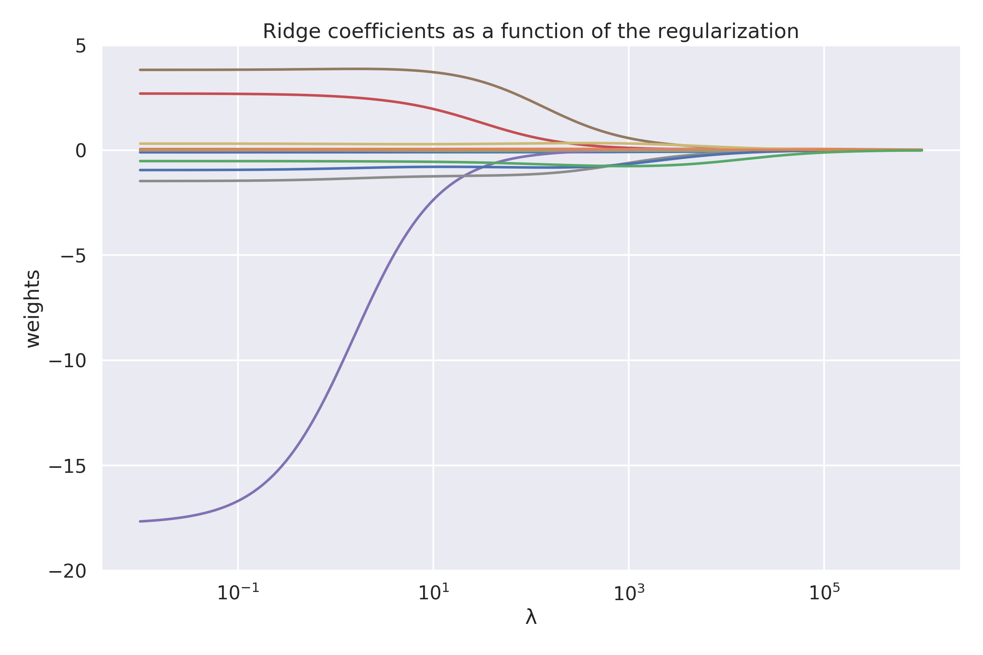
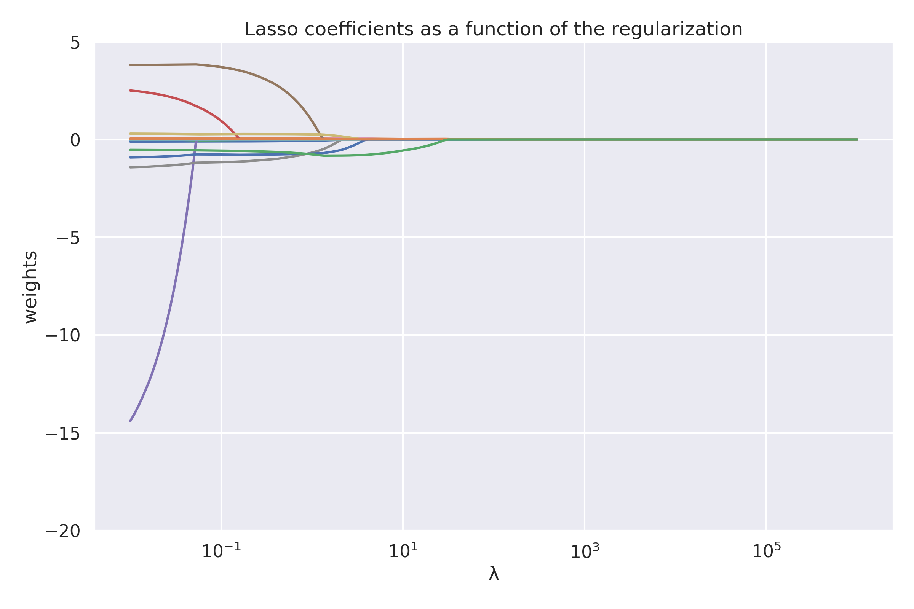
Ridge vs. Lasso

Slide 37
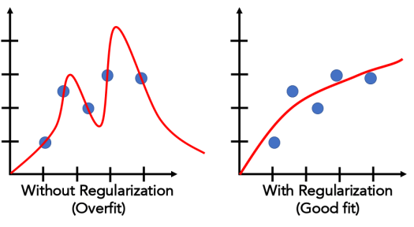
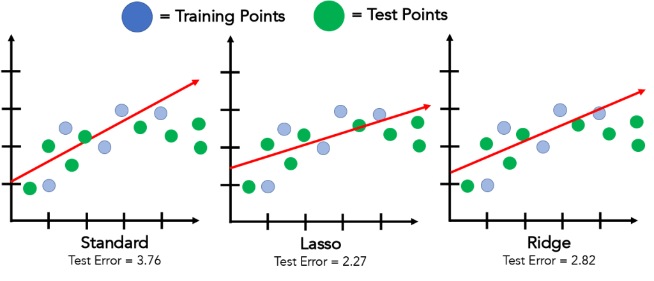
Regularization
For linear/polynomial regression: penalizing larger coefficients results in “flatter” curves.
Notes:
Left image:
Normal linear regression vs lasso/ridge.
Remember they haven’t been introduced to the concept of training/testing sets yet.
Right image:
Normal polynomial regression vs with some regularization (exaggerated).

Slide 38
Elastic net regression
Generally, we care about getting the best performance on the test set. We don’t care if we do it using L1 or L2 regularization
Elastic net uses both, each with their own λ

Slide 39
Picking λ
If λ is too small, we can overfit (model too complex)
If λ is too large, we can underfit (model ignores prediction error)
Like all other hyperparameters, the simplest way to pick it is to try a lot of values and see which works best when predicting unseen data (test set)

